Slide 1

Deep Uncertainty Quantification: A Machine Learning Approach for Weather Forecasting
Ph.D student: Bin Wang
Supervisor: Prof. Guangquan Zhang
Co-Supervisor: Dist. Prof. Jie Lu
DeSI Lab, Centre for Artificial Intelligence, FEIT, UTS

Slide 2

Outline
Deep Learning for Time Series Forecasting
Deep Learning only Single-value Forecasting (previous)
Disadvantage
Deep Learning with Uncertainty Quantification (ours, DUQ)
Basic Ideas
Methodology
An application: DUQ for Weather Forcasting
Superiority
Summary

Slide 3
Deep Learning only Single-value Forecasting
Historical time series
Forcastings
Ground Truth
Forecasting
T+1
T+2
T+3
……
T+n
Time
Disadvantage:
IGNORE model uncertainty and data noise.
ONLY partial information and UNSAFE for decision-making.

Slide 4
Deep Learning with Uncertainty Quantification (DeepUQ)
Historical time series
Forcastings
Ground Truth
Forecasting
Upper, Lower Bound
T+1
T+2
T+3
……
T+n
Time
Basic Ideas:
Predict an upper, lower Bound (Uncertainty Quantification)
to cover ground truth with a probability P such as 90%.
4

Slide 5
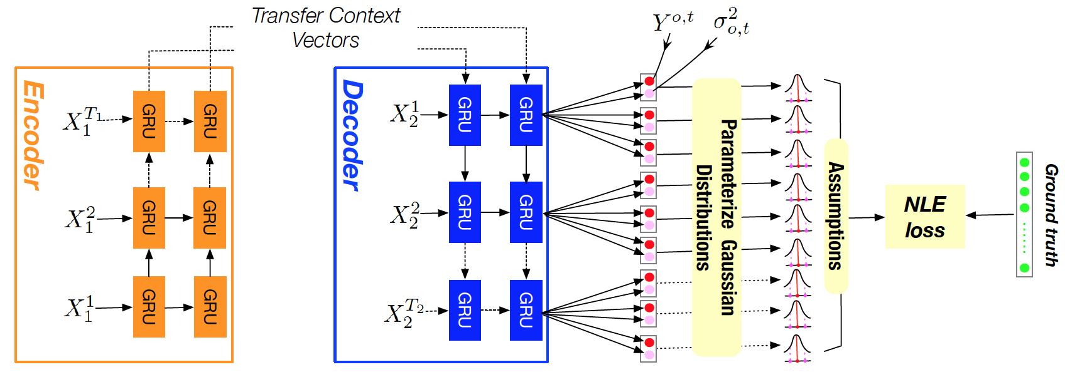
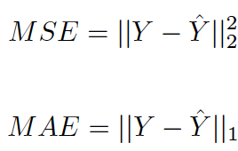
Methodology
Forecast sequential point estimation and prediction interval by end-to-end learning.
Ground truth
Historical time series
Forcastings
T+1
T+2
T+3
……
T+n
Time

Slide 6
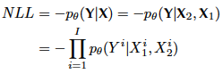
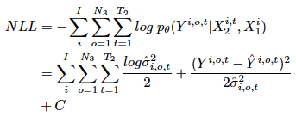
Loss function
Traditional loss function
V.S.
Our loss function
--- Negative Likelihood Loss (NLL)
Three
assumptions:
1. Each training sample is independent.
2. Each target output variable and each timestep are conditionally independent given X.
3. Ground truth Y satisfies multivariate independent Gaussian distribution.
L1, L2 and Dropout regularization
Decomposed
As bellows:
Optimized by BP
Optimized by BP ☺

Slide 7
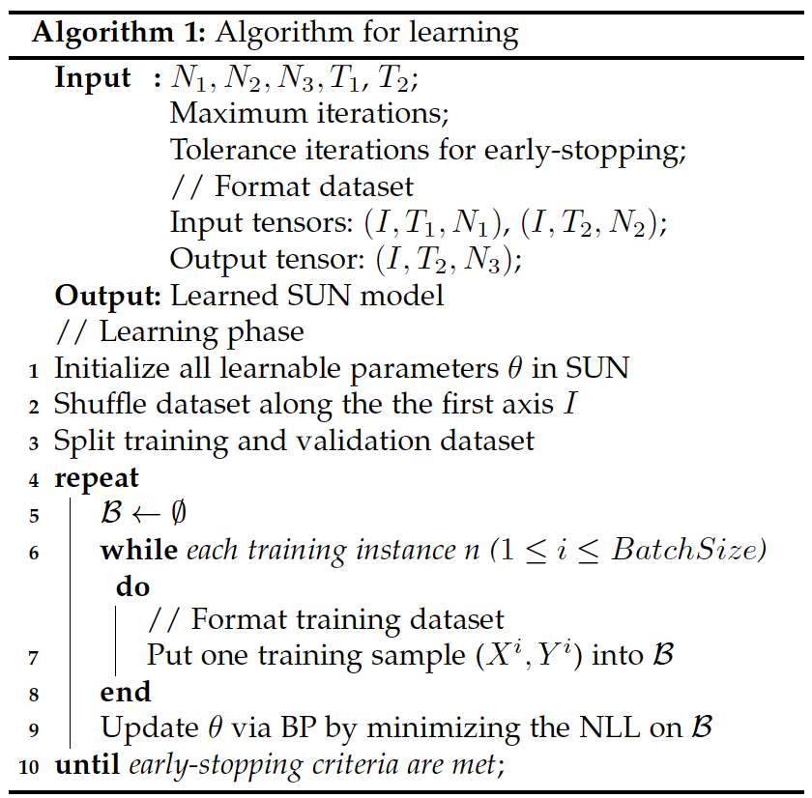
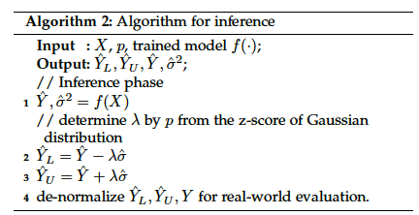
Learning Algorithm
Inference Algorithm
Batch training;
Early-stopping;
Back-Propogation;
…
Z-score of Gaussian Distribution
Deep Learning
Techniques:

Slide 8
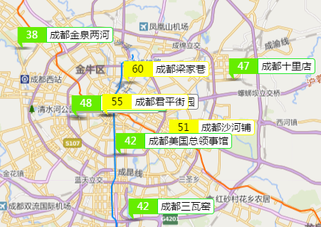
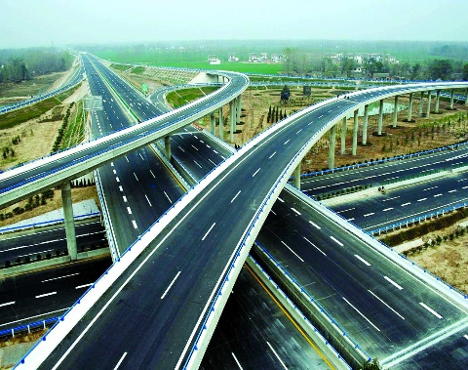
Application of Weather Forecasting
Economy
Life, Travel, Military …
Energy (Wind, Solar)
Forecasting
Load
Forecasting
Air Quality Prediction
Traffic Flow Prediction

Slide 9
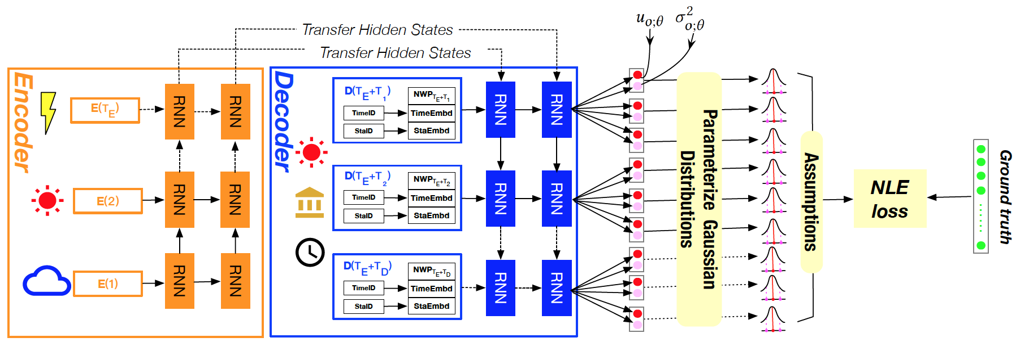
Solution: DUQ for Weather Forecasting
A deep learning-based method---deep uncertainty quantification (DUQ)
Meteological series of yesterday
Station ID (Embedding);
Time ID (Embedding);
NWP Forecasting
Target variables series

Slide 10
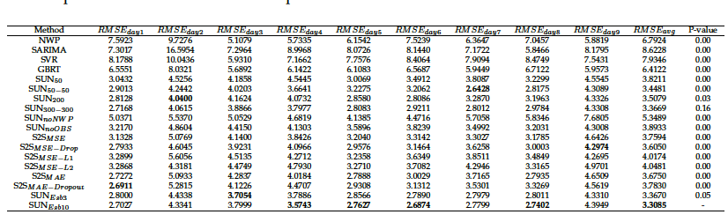
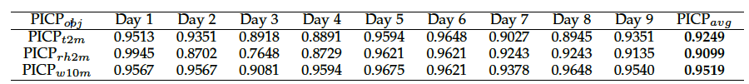
Metric of single-value forecasting:
Root mean squared error (RMSE)
Mean absolute error (MAE)
Numeric Weather Forecasting (NWP), a classical method in meterology field.
6.7924
Reduce error up to 47.76%
3.3085
Ours DUQ method
We can say:
Our prediction will be located in [lower, upper], with probability 90%!
Metric of uncertainty quantification:
Prediction interval coverage probability (PICP)

Slide 11

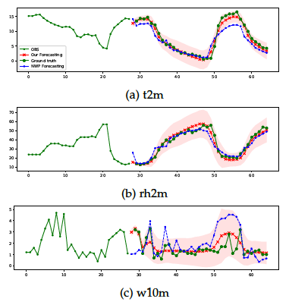
Visualization
Right red: DUQ forecasting
Right blue: NWP forecasting
Right green: furture ground truth
Left green：meteorology of yesterday
Achieved 2rd place in a real-world
Weather Forecasting Competition.
temperature
Mostly change (large variance)
during the daytime and become more stable during night (small variance)
relative humidity
More Experimental analysis ….
Effect of information fusion
Effect of deep layers.
Effect of loss function
Effect of ensemble
Discuss instability of weather forecasting
Evaluation by RMSE
Quantity of prediction interval.
Quality of prediction interval.
Significance of T-test.
Fluctuates sharply, it is more challenging to predict.
Wind speed

Slide 12
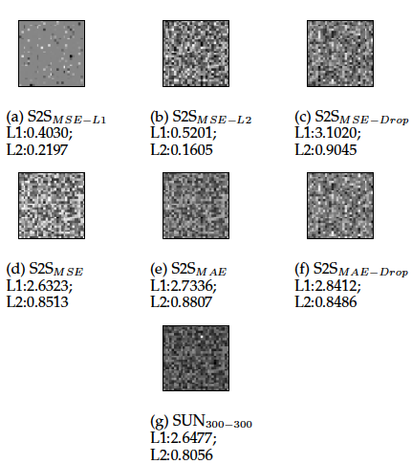
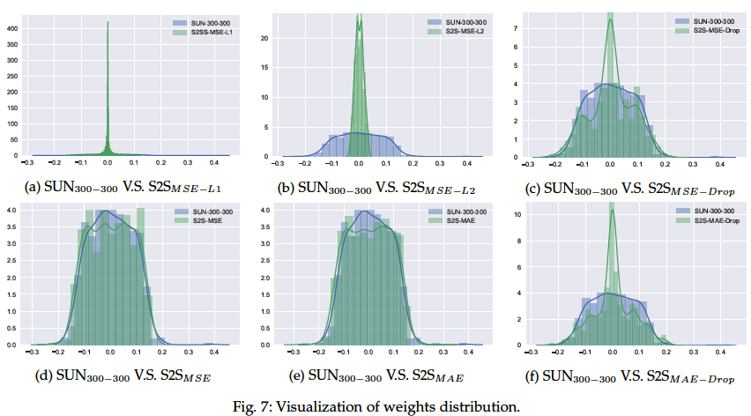
A novel phenomenon was reported
Trained by NLL has better generalization than MAE/MSE with Dropout and L1/L2 regularization.
Our weights: distribute smoothly
Dropout: locally clustered
Matrix of Learned Weights
Distribution of Learned Weights

Slide 13
Take Home Message
U
Only single-value forecasting is NOT enough for decision-making.
Not only forecasts single-value, but also forecasts prediction interval.
Optimized by BP. While Bayesian deep learning need variational inference.
DUQ got superio results by taking advantages of deep learning.
Phenomenon: Training by NLL brings better generalization than MAE and MSE.
Scalable to other time series forecasting.

Slide 14
THANK YOU!
Q & A
Bin.Wang-7@student.uts.edu.au

